Slide 1
Project Review-3
On
UWB-Based Indoor Localization and Tracking System
by
Ambar Roy (RA2211004010332)
Shubham Ranjan (RA2211004010346)
Kshitij Srivastava (RA2211004010344)
Supervisor Name & Designation
Dr. J. Subhashini
Associate Professor, Department of ECE

Slide 2
Flow of Presentation
Introduction
Literature Survey
Problem Statement
Objective
Block diagram
Design Methodology (Flowchart /Algorithm )
Software / Hardware Details
Results
Project plan
Conclusion
References

Slide 3
1. Introduction
Indoor localization is a key technology for smart environments such as retail, logistics, warehousing, healthcare, and Industry 4.0.
Conventional positioning systems like GPS are ineffective indoors due to signal attenuation and multipath interference.
Alternative technologies such as Wi-Fi and Bluetooth Low Energy provide partial indoor localization but suffer from limited accuracy, high infrastructure cost, and energy inefficiency.
Ultra-Wideband (UWB) offers centimeter-level positioning accuracy but is limited by short-range coverage.
To address ensure both coverage and accuracy, this project proposes a hybrid UWB–LoRa Indoor Localization and Tracking System.
LoRa enables long-range, low-power communication across large indoor retail spaces.
UWB provides high-precision localization within specific product zones and racks.
The hybrid approach enables a store-wide “indoor GPS” with rack-level product identification, making it suitable for large departmental stores such as IKEA and D-Mart.

Slide 4
2. Literature Survey
Author/Journal Name | Title | Methodology | Summary
F. Zafari, A. Gkelias, K. K. Leung (IEEE Communications Surveys & Tutorials) | A Survey of Indoor Localization Systems and Technologies (2021) | • Systematic review of indoor localization techniques. • Comparison of Wi-Fi, BLE, UWB, RFID | Provides a comprehensive overview of existing indoor localization technologies
H.Al-Tarawneh, M. Saraireh, M. Alsharif (Wireless Networks – Springer) | A Review of Indoor Localization Techniques and Wireless Technologies (2021) | • Comparative analysis of wireless technologies used for indoor localization. • Evaluation based on accuracy, power consumption | Concludes that no single technology satisfies all indoor localization requirements, emphasizing hybrid solutions for large environments.
S. Subedi et al. (Applied Sciences – MDPI) | Indoor Positioning Technologies for Smart Environments (2022) | • Review of UWB-based indoor positioning methods • Analysis of ToF and trilateration techniques | Demonstrates that UWB provides centimeter-level localization accuracy for smart indoor environments.
W. Ma et al. Measurement: Sensors (Elsevier) | Indoor Positioning Algorithm Based on TOA and Kalman Filter(2024) | • UWB-based indoor positioning using Time of Arrival (TOA) ranging | TOA-based UWB ranging with Kalman filtering significantly reduces noise and improves indoor positioning accuracy.
4

Slide 5
Literature Survey
Author/Journal Name | Title | Methodology | Summary
M. Khelifi, A. Bradai, A. Benslimane, M. Amjad (Sensors-MDPI) | Recent Advances and Challenges in Indoor Localization Systems (2022) | Reviews and classifies recent indoor localization techniques. | Highlights scalability, cost, and robustness as major deployment challenges.
J. Yang et al. (Sensors – MDPI) | UWB Indoor Positioning System Based on TOF and Kalman Filtering (2023) | • ToF-based UWB ranging • Trilateration with Kalman filtering | Shows that Kalman filtering significantly improves UWB positioning accuracy in noisy indoor environments.
M. F. R. Al-Okby et al. (Applied Sciences – MDPI) | UWB-Based Real-Time Indoor Positioning Systems: A Comprehensive Review (2024) | • Review of real-time UWB indoor positioning systems • Analysis of algorithms and architectures | Provides an up-to-date overview of real-time UWB indoor positioning techniques and applications.
W-P. Lin & Y-S. Lu (Algorithms-MDPI) | A High-Precision UWB-Based Indoor Positioning System Using TOA(2025) | Reviews LPWAN-based indoor localization approaches. | Concludes LPWAN requires integration with high-accuracy techniques.
5

Slide 6
3. Problem Statement
Large departmental stores (1–2 km) contain thousands of products across many racks, making item navigation difficult.
Customers must manually search shelves, increasing shopping time and confusion.
Existing store layouts are unfamiliar to customers, leading to poor shopping efficiency and increased staff assistance.
Current solutions relying on Wi-Fi or GPS are unreliable or ineffective for accurate indoor navigation.
There is a need for a low-cost, scalable indoor navigation system that provides store-wide guidance and precise rack-level product localization.

Slide 7
4. Objective
The primary objective is to design and implement a hybrid UWB–LoRa indoor localization system that supports both store-level navigation and precise product-level tracking.
To enable real-time product search using a smart shopping cart equipped with a display, UWB tag, and LoRa transceiver.
To ensure meter-level positioning accuracy within each product zone using UWB technology.
To achieve store-wide communication and data exchange across large indoor spaces.
To highlight seasonal top-selling products based on historical sales trends, allowing the system to dynamically promote relevant items to customers.

Slide 8
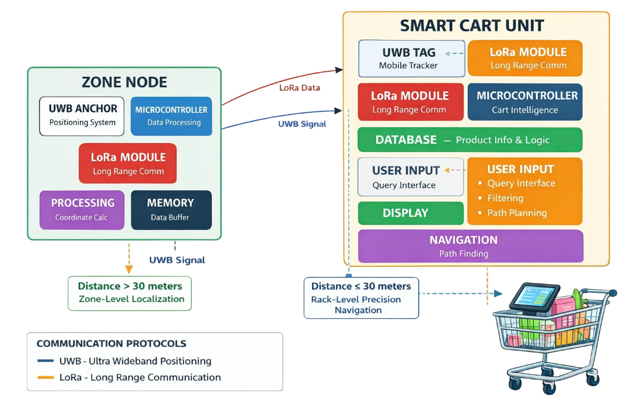
5. Block Diagram
Fig.5.1: Block Diagram of Smart Cart Navigation System Using LoRa and UWB
8

Slide 9
Block Diagram Description
The system architecture consists of two major subsystems:
Zone Nodes and the Smart Cart Unit.
Each Zone Node contains an ESP32 microcontroller, a UWB anchor, and a LoRa module. These nodes store product coordinate information and transmit it to the cart when queried. UWB anchors placed at known coordinates enable precise ranging when the cart enters the zone.
The Smart Cart Unit integrates an ESP32 controller, UWB tag, LoRa transceiver, TFT display, and battery. When a user searches for a product, the cart sends a LoRa request to all zones; the node containing the product responds with the rack coordinates. The cart display then highlights the zone on the store map. As the cart approaches and enters that zone, UWB communication becomes active and computes the cart's exact position using Time-of-Flight and trilateration techniques.
This layered architecture efficiently combines macro-level navigation using LoRa and micro-level precision using UWB, ensuring a reliable and scalable solution for large indoor spaces.

Slide 10
6. Design Methodology (Flowchart / Algorithm)
Load map & product DB; Init UWB, LoRa, Display
↓
User enters product name
↓
Cart broadcasts LoRa query → All Zone LoRa nodes
↓
Zone node(s) reply with {Zone ID}
↓
Cart receives response → Show route on map
↓
Navigate (coarse) toward target zone
↓
Detect entry to target zone (LoRa proximity / anchor beacon / RSSI)
↓
Activate UWB ranging with anchors in zone
↓
Measure ToF distances → Trilateration → Raw Position
↓
Kalman filter (or complementary filter) → Smoothed Position
↓
Display precise rack/shelf location
↓
User reaches product → End / New Query

Slide 11
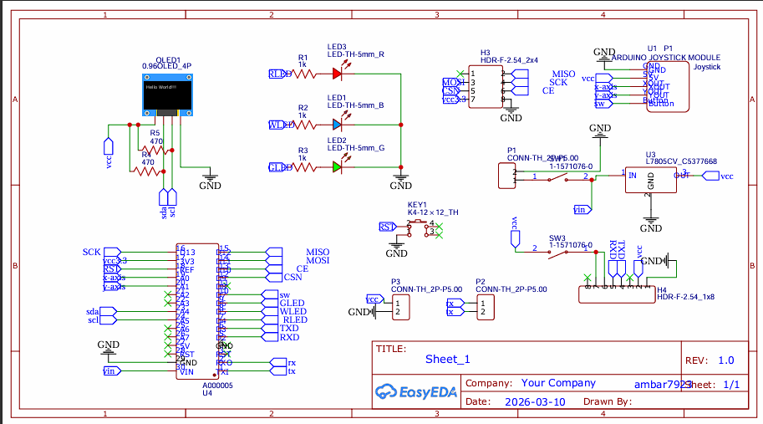
Schematic and PCB layout
Fig 6.1- Schematic diagram

Slide 12
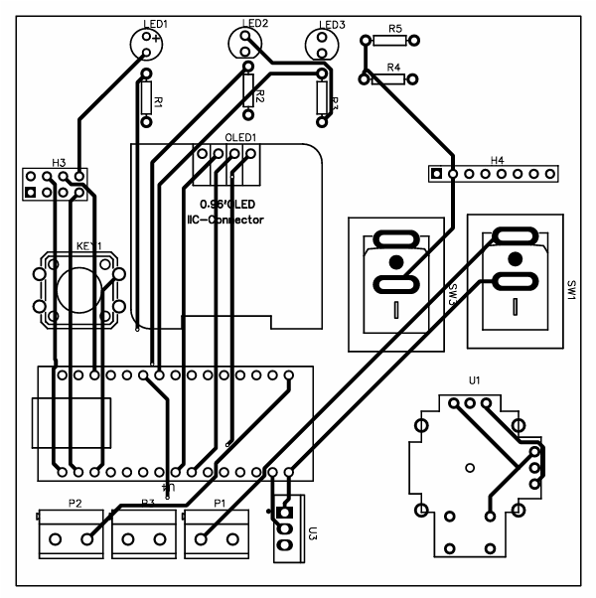
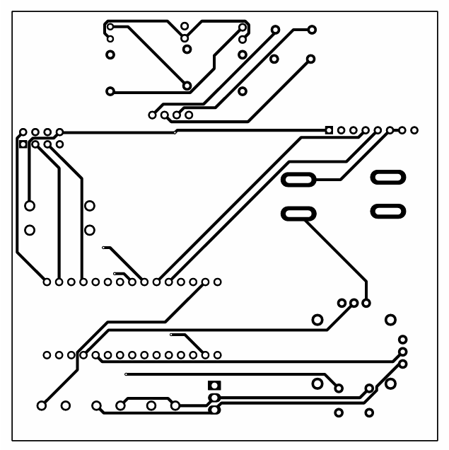
Fig 6.2- Top Layer
Fig 6.3- Bottom Layer

Slide 13
7. Software & Hardware Details
The entire system is implemented and validated using MATLAB as a real-world simulation platform. MATLAB is used for 2D indoor map visualization, GUI development, distance computation, noise modeling, Kalman filtering, and shortest-path planning. LoRa-based zone-level distance estimation is simulated using an RSSI path-loss model with added Gaussian noise to represent real wireless interference, while a Kalman filter is applied to reduce measurement fluctuations and improve accuracy. UWB-based rack-level distance estimation is simulated using high-precision coordinate-based ranging with noise injection to emulate real UWB behavior. Real-time GUIs display noisy and filtered distances, along with dynamic graphs comparing raw and filtered signals.
On the hardware side, the system is designed as a hardware-equivalent simulation due to cost and deployment constraints. Each shopping zone is assumed to contain a LoRa node (e.g., SX1276/SX1278) for long-range, low-power zone detection, while each rack is equipped with a UWB anchor (e.g., DWM1000/DWM3000) for accurate short-range localization. The smart shopping cart acts as a mobile node containing both LoRa and UWB modules controlled by a microcontroller (such as ESP32). This simulated setup closely replicates real-world indoor positioning behavior and allows complete system validation without physical hardware.

Slide 14
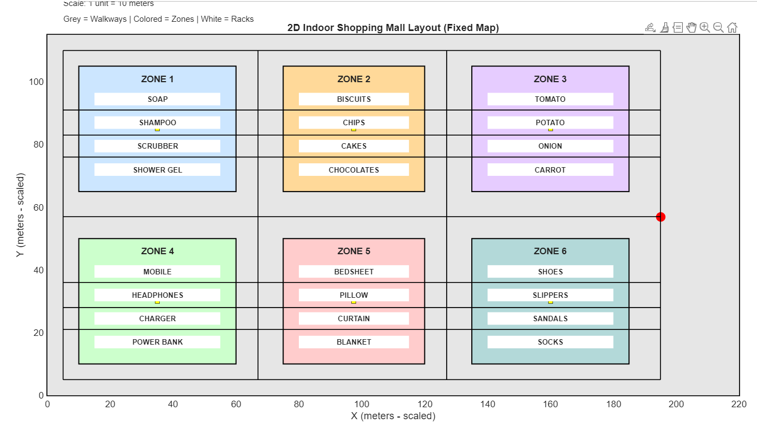
Results
Grid-Based Path Planning Using Invisible Walkway Graph
Figure 8.5: Grid based path planning for shortest route
Each zone and rack is not directly traversable; instead, movement is constrained to predefined horizontal and vertical grid lines, similar to real shopping mall pavements.
The black grid lines represent logical walkways used internally for routing, even though they are not physical walls.
The red cart position represents the current location of the user, and routing is performed only along grid intersections, completely avoiding diagonal or rack-crossing paths.
STARTING POINT

Slide 15
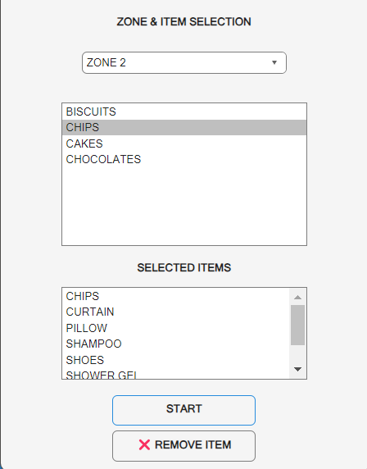
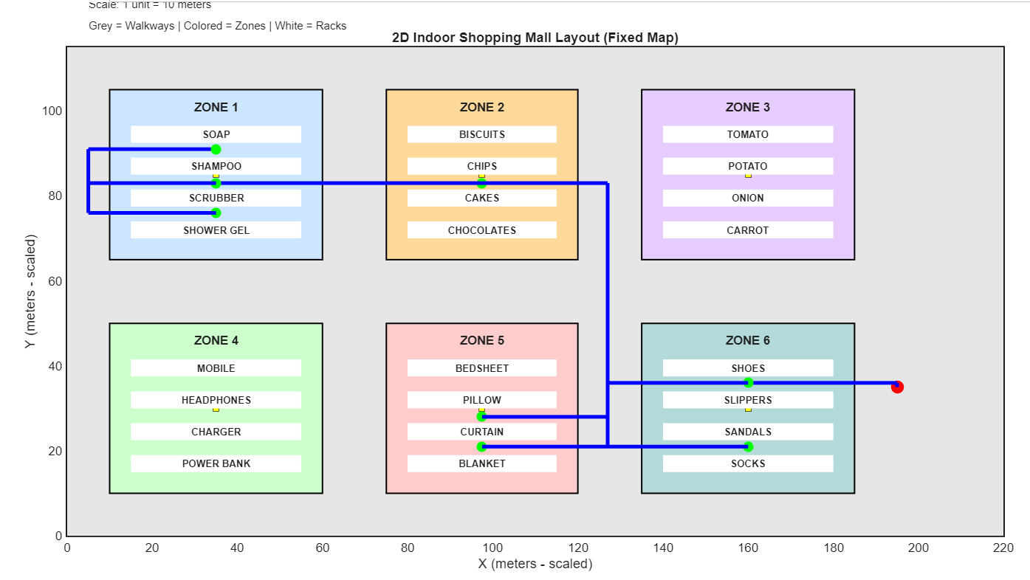
Results
Product Selection and Shortest Path Mapping
Figure 8.6: Shortest Path Visualization for Selected Products
Users can select multiple products across different zones using the GUI. Path dynamically changes based on selected products. The routing algorithm ensures aisle-based navigation. Product destinations are marked clearly on the map.
The system successfully generates an optimized shopping route, improving navigation efficiency.

Slide 16
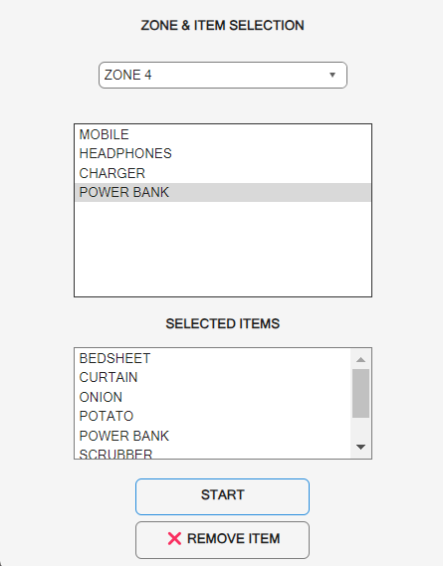
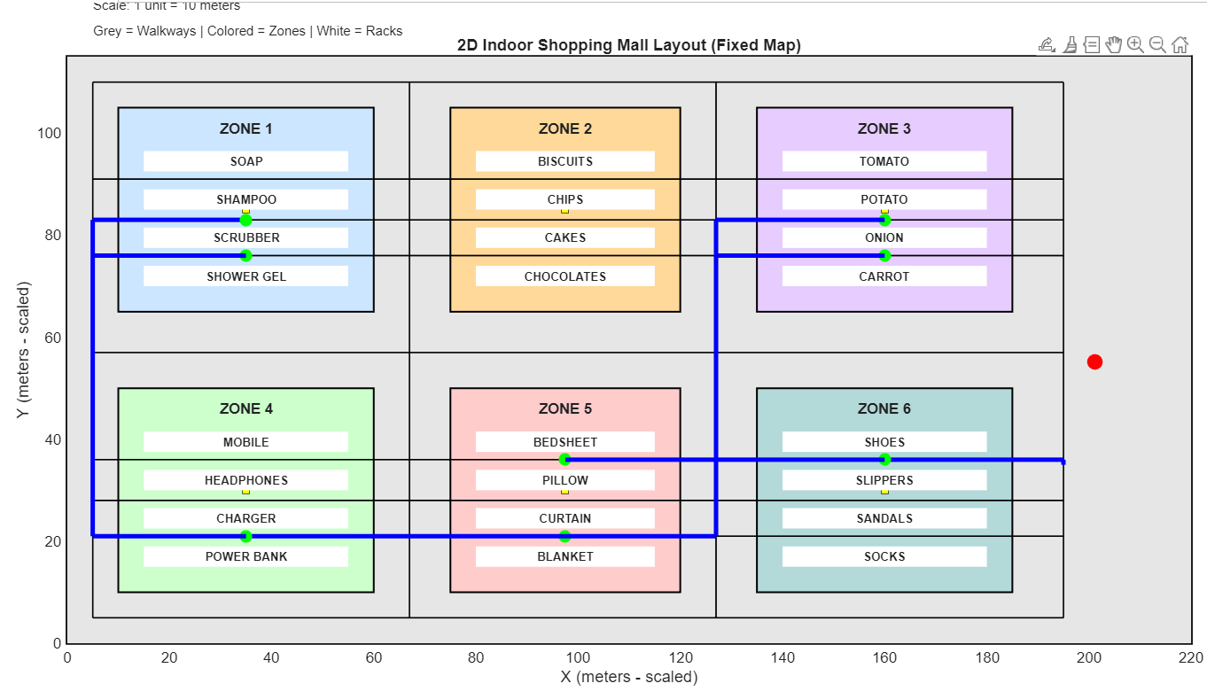
Results
Product Selection and Shortest Path Mapping
Figure 8.7: Shortest Path Visualization for Selected Products
This slide demonstrates the shortest path computation for a shopping cart navigating through an indoor mall layout using a grid-constrained routing approach. The path connects multiple selected product locations while strictly following predefined walkable aisles.

Slide 17
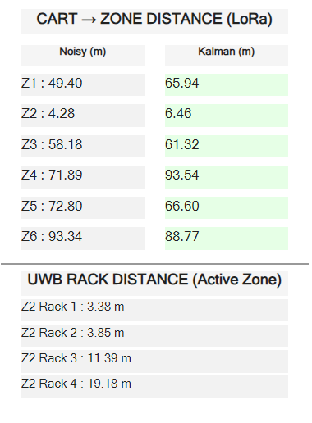
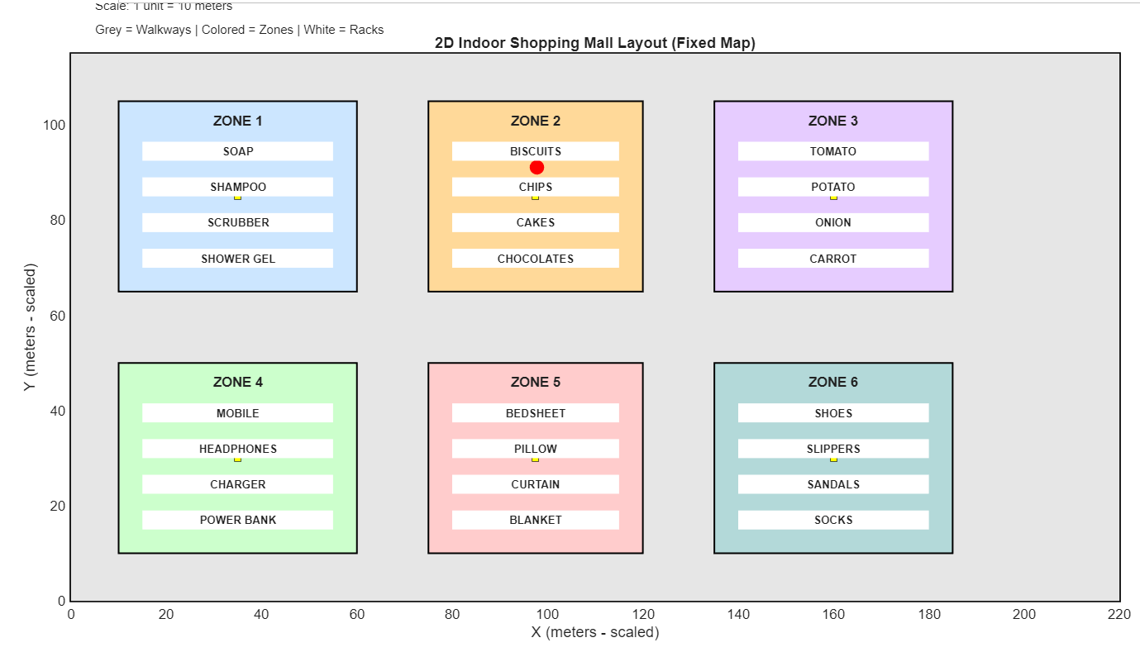
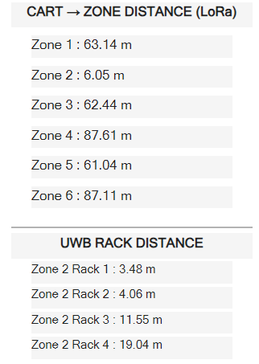
Results
LoRa-Based Zone-Level and UWB Rack-Level Distance Estimation
Fig.8.2: LoRa Distance Monitoring GUI
LoRa modules are assumed to be deployed at the center of each zone in the shopping mall. The cart position acts as a mobile LoRa node. The distance between the cart and each zone is estimated using a log-distance path loss model, which converts simulated RSSI values into distance.
While UWB technology is used for high-accuracy rack-level distance estimation. Each rack within a zone is assumed to contain a UWB anchor node. UWB ranging is activated only when the cart enters a predefined proximity threshold (30 meters) of a zone, reducing unnecessary computation.

Slide 18
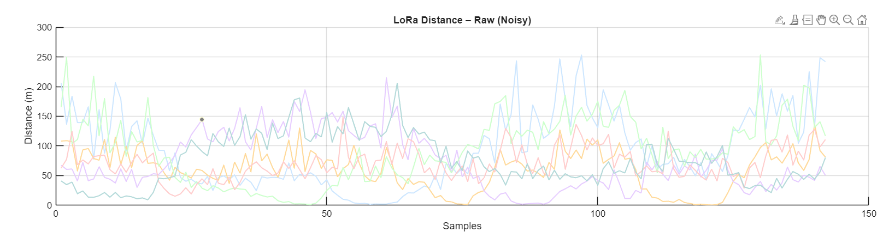
Results
Effect of Noise on LoRa Distance Measurement
Fig8.3: LoRa Distance with Noise
Noise introduces random fluctuations in distance readings. The noisy distance deviates from the true distance, especially at larger ranges. This behavior closely matches real LoRa signal characteristics such as multipath and fading.
Due to RSSI noise, multipath fading, and interference, distance estimates from different zones (e.g., Zone 3 and Zone 6) overlap, making it difficult to uniquely identify the cart’s actual zone.
The simulation successfully demonstrates how noise affects LoRa-based distance estimation.
ZONE 6
ZONE 3

Slide 19
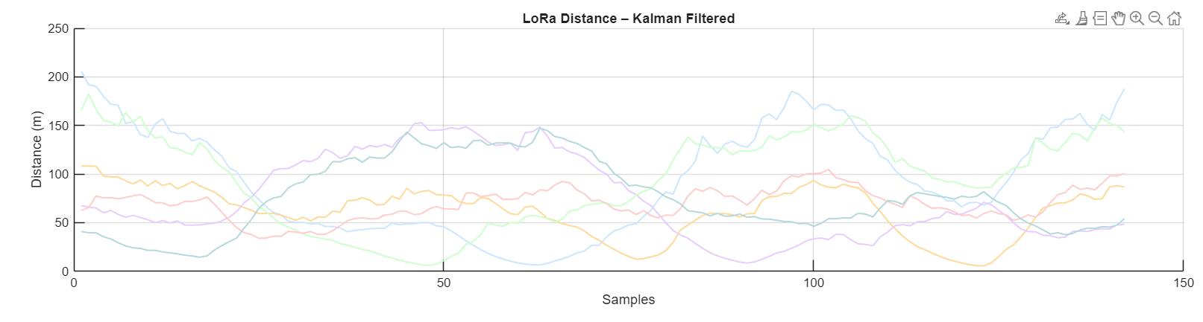
Results
Filtering of Noisy LoRa Distance Measurements
Figure 8.4: Filtered LoRa Distance
Filtered distance is significantly smoother than raw noisy distance. Sudden spikes due to noise are reduced. 1-Dimensional Kalman Filter is applied to the LoRa-based distance measurements for each zone.
The Kalman filter suppresses random noise and smooths distance estimates over time, clearly separating zone-wise distances and enabling reliable cart localization based on the nearest zone.
Filtering improves distance stability and accuracy, validating the need for signal processing in real-world localization systems.
ZONE 3
ZONE 6

Slide 20
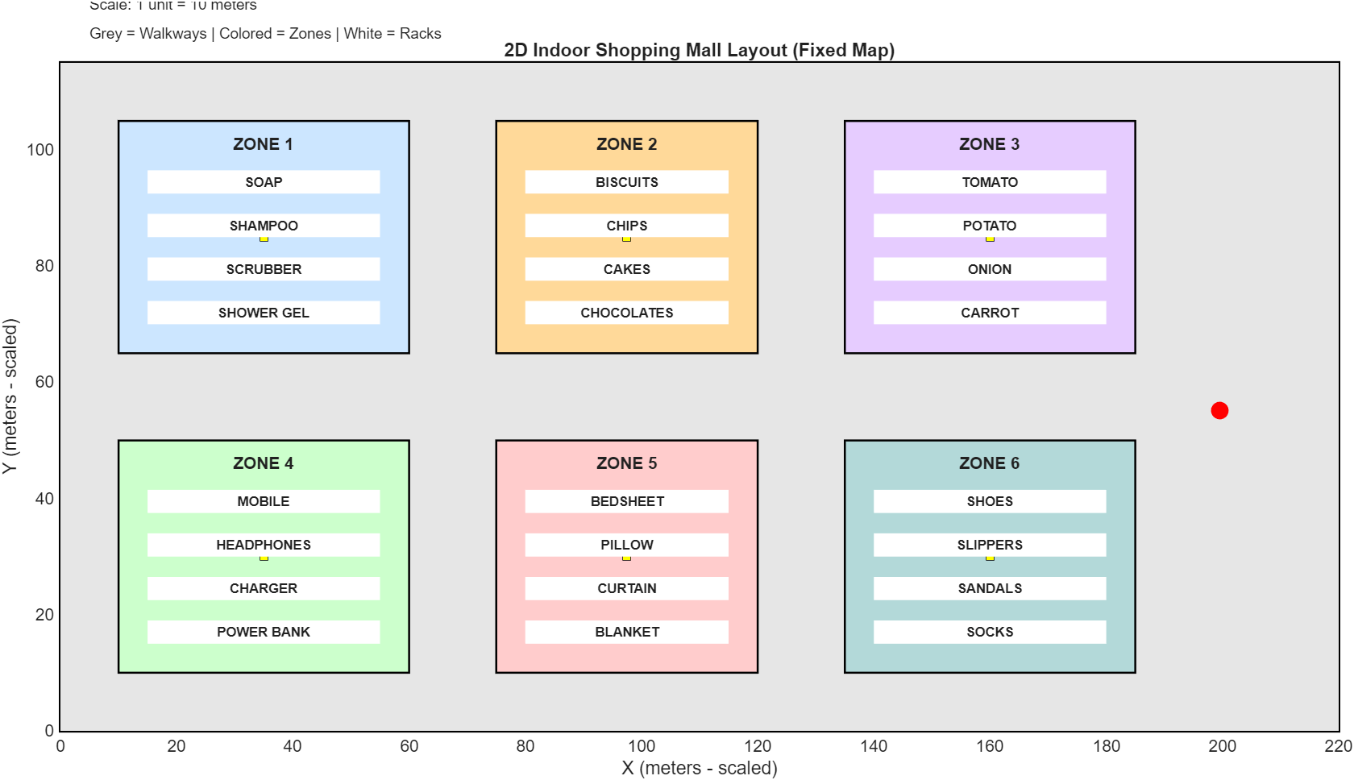
8. Results
Indoor Mall Layout and System Visualization
Fig. 8.1: 2D Indoor Shopping Mall Layout
A 2D indoor shopping mall layout was successfully created in MATLAB, representing a large-scale shopping complex of 2 km × 1 km (scaled).
The system visually differentiates zones, racks, aisles, and the shopping cart position, providing a clear and realistic indoor environment for navigation simulation.

Slide 21
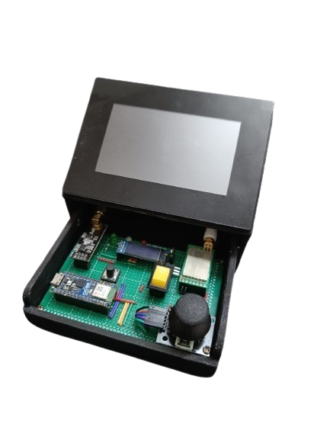
Results
The developed hardware prototype demonstrates the practical implementation of the proposed indoor localization and navigation system. The device integrates key components including the microcontroller, UWB communication module, LoRa module, and a touchscreen display within a compact enclosure. This setup enables real-time localization processing and communication between system nodes. The prototype validates the feasibility of the proposed architecture and serves as a functional platform for testing indoor navigation and positioning performance.

Slide 22
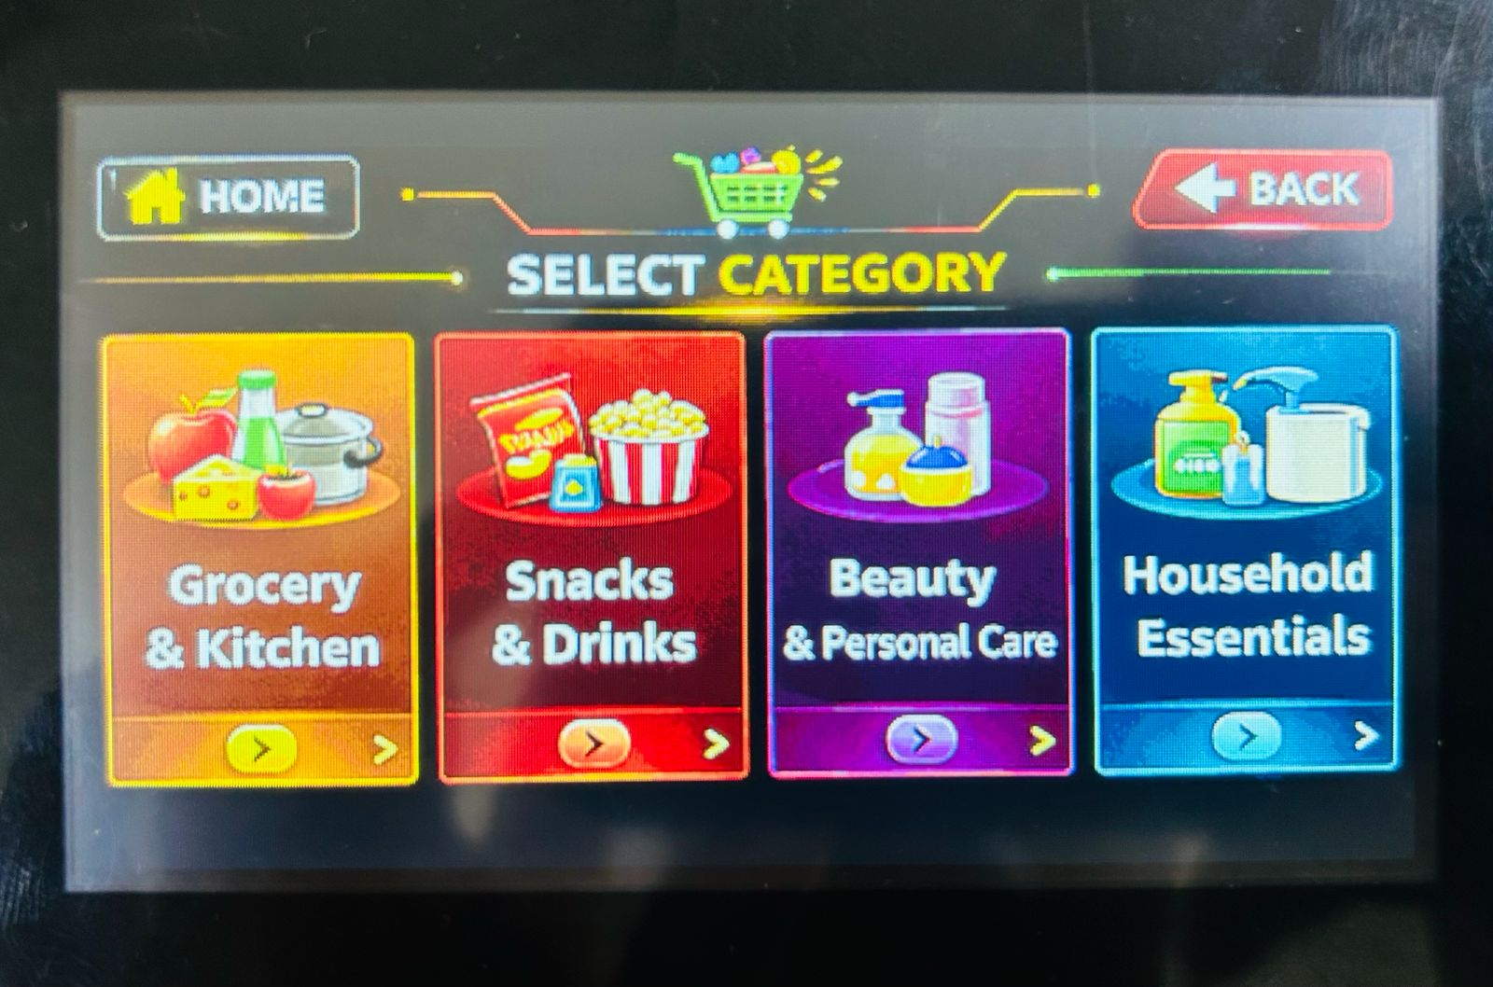
Results
To enable real-time product search using a smart shopping cart equipped with a display, UWB tag, and LoRa transceiver.
Fig 8.2- Product List

Slide 23
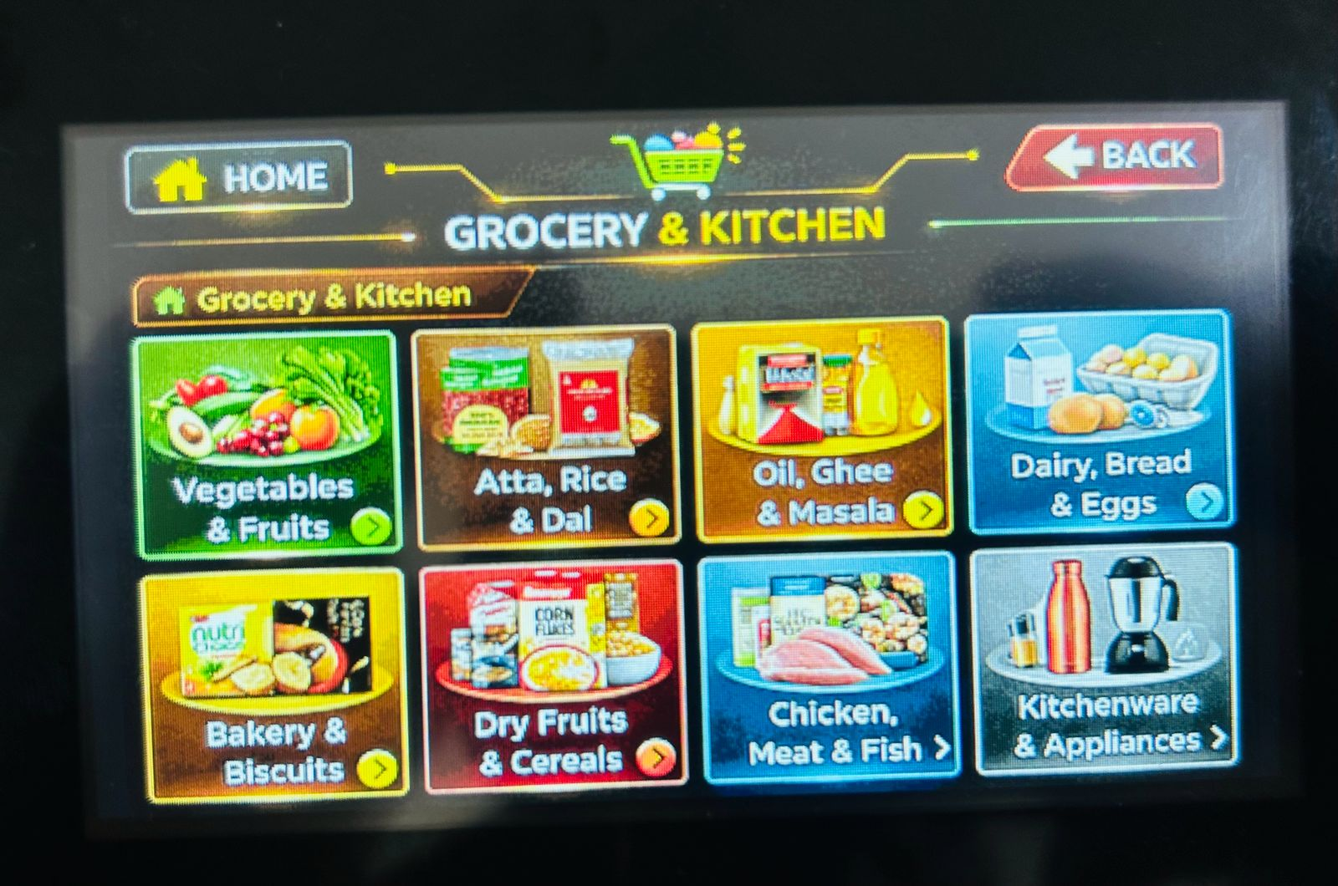
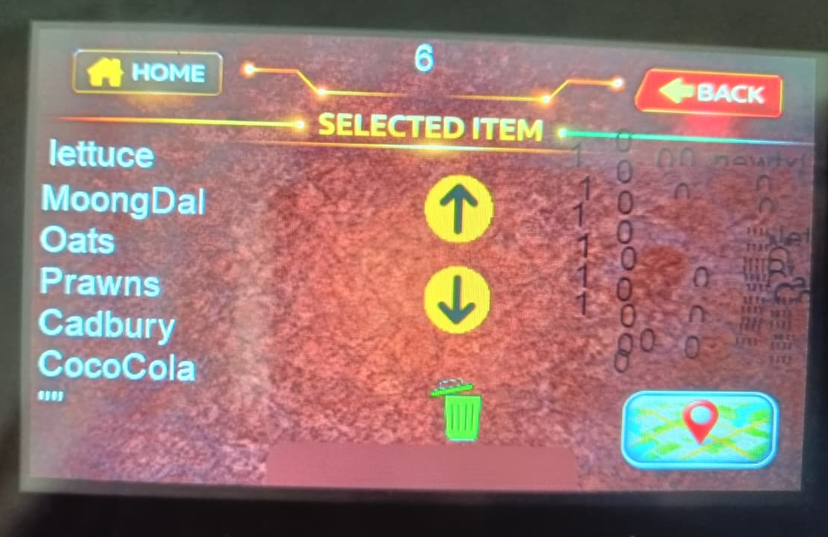
Results
To enable real-time product search using a smart shopping cart equipped with a display, UWB tag, and LoRa transceiver.
Fig 8.3- Sub Product List and product cart list.

Slide 24
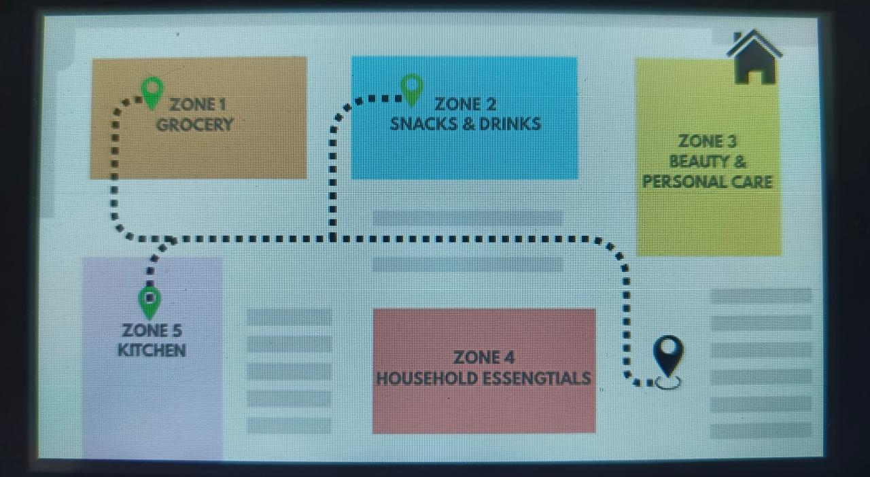
Results
Successfully developed a graphical indoor navigation interface for different store zones.
Fig 8.5- Zone-Level Indoor Navigation Interface

Slide 25
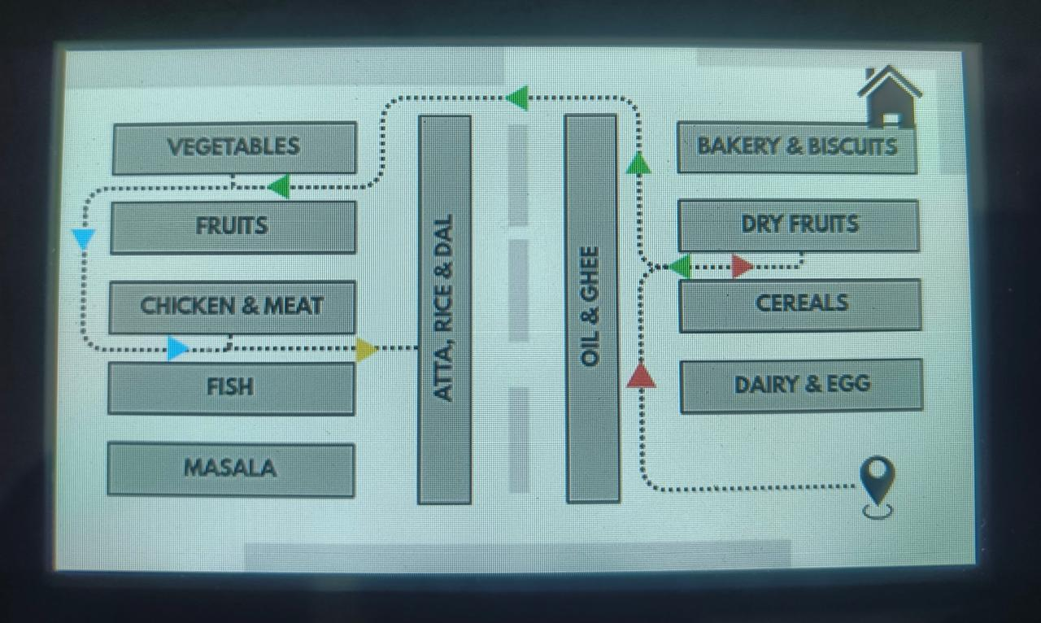
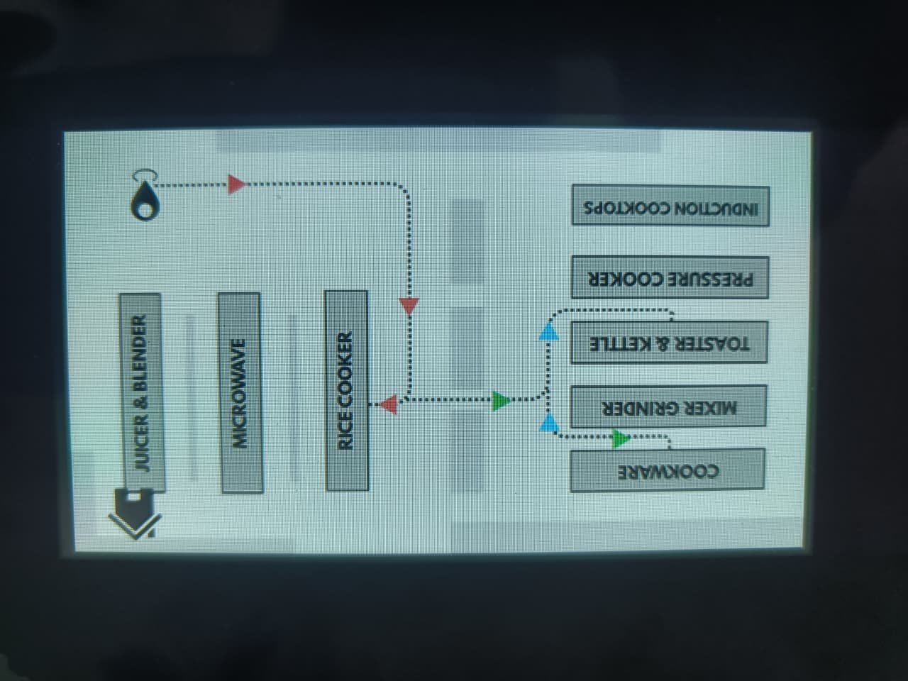
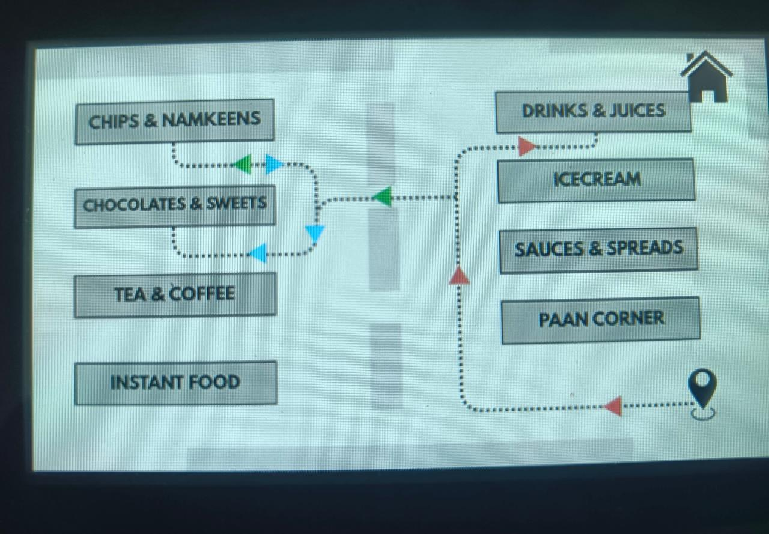
Results
Real-time path guidance is generated from the current position to the selected product location.
Fig 8.6- Product Rack Navigation in Zone wise.

Slide 26
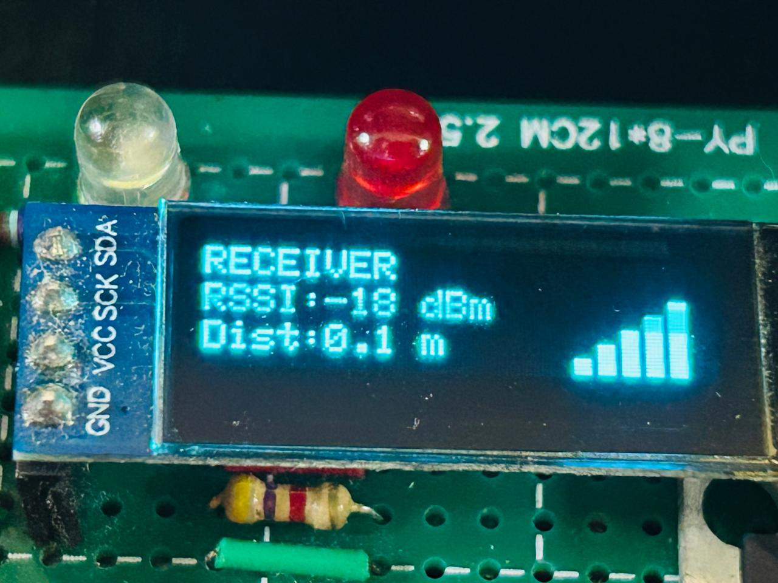
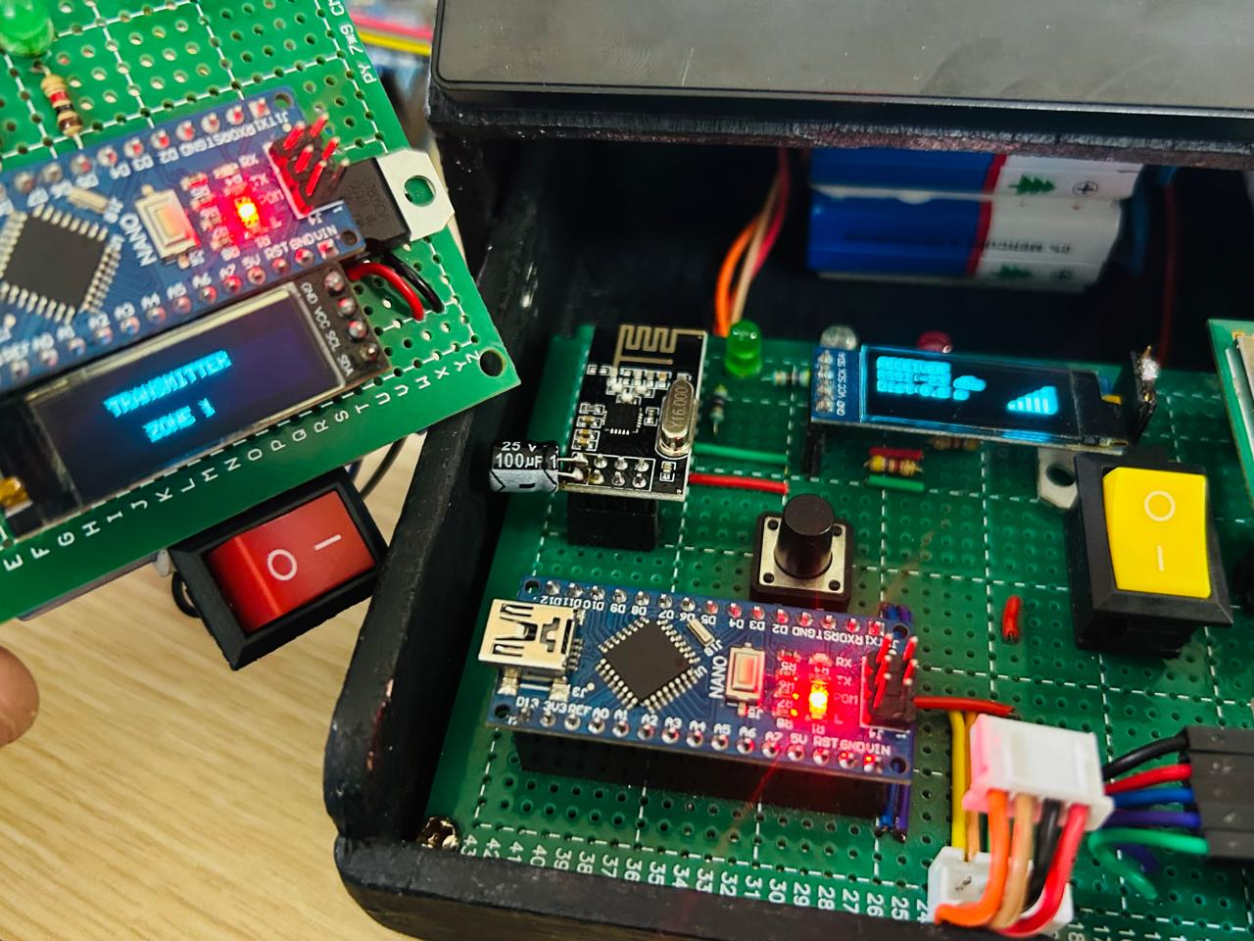
Results
To ensure meter-level positioning accuracy within each product zone using UWB technology.
Fig 8.4- Meter Level Positioning

Slide 27
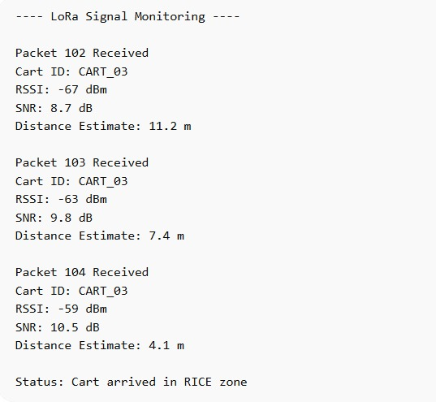
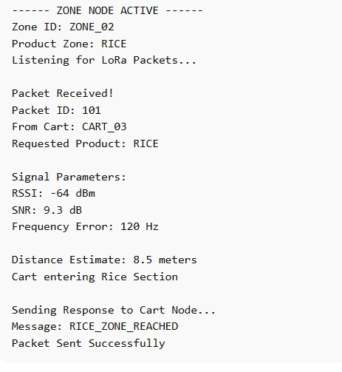
Results
To achieve store-wide communication and data exchange across large indoor space.
Fig 8.4- Serial Monitor Results of LoRa Communication Between Cart Node and Zone Node

Slide 28
Results
Table 1: Experimental Result.
Test Case | Distance Covered (m) | UWB Position Error (m) | LoRa Packet Success (%) | Path Deviation (m) | Total Time (ms)
Test 1 | 120 m | 0.18 m | 98% | 0.25 m | 310 ms
Test 2 | 210 m | 0.32 m | 95% | 0.48 m | 420 ms
Test 3 | 340 m | 0.58 m | 91% | 0.85 m | 610 ms
Test 4 | 480 m | 0.42 m | 93% | 0.62 m | 780 ms
Test 5 | 500 m | 0.75 m | 88% | 1.20 m | 920 ms

Slide 29
9. Project Plan
Phase 1: Requirements & Design (Week 1-2)
Define problem statement, system objective (LoRa + UWB hybrid), block diagram, and architecture.
Phase 2: Indoor Environment Modeling (Week 3–4)
Create MATLAB-based 2D indoor mall layout with zones, aisles, racks, and cart visualization..
Phase 3: LoRa Distance Simulation (Week 5)
Simulate RSSI-based LoRa zone-level distance estimation with indoor noise modeling..
Phase 4: Noise Analysis & Filtering (Week 6–7)
Analyze noise impact on LoRa distance and implement 1D Kalman Filter for smoothing..
Phase 5: UWB Localization Simulation (Week 6–7)
Simulate high-accuracy UWB rack-level ranging activated near target zones..
Phase 6: Product Search Logic(Week 8)
Implement product selection mechanism using locally stored zone and rack data..
Phase 7: Shortest Path Navigation (Week 9)
Develop aisle-based shortest path algorithm for optimized indoor navigation.
Phase 8: Result Visualization(Week 10)
Visualize distance plots, filtered results, zone detection, and navigation paths.

Slide 30
10. Conclusion
Successfully demonstrates a realistic indoor navigation and localization system using LoRa and UWB technologies, modeled through a MATLAB-based hardware simulation. LoRa enables zone-level distance estimation with low power consumption, while UWB provides high-accuracy rack-level ranging, making the system suitable for complex indoor environments such as shopping malls.
The introduction of noise modeling and 1D Kalman filtering effectively improves distance stability, closely reflecting real-world wireless behavior. By implementing local data storage and on-device processing, the system eliminates dependency on centralized servers, enhancing reliability and scalability. The shortest-path routing along predefined aisles ensures practical navigation without crossing racks, mimicking real customer movement.
Overall, the project validates the feasibility of a smart cart–based indoor navigation system and establishes a strong foundation for future hardware implementation and real-time deployment.

Slide 31
11. References
[1] W. Ma, “Research on Indoor Positioning System Algorithm Based on TOA and Kalman Filter,” Measurement: Sensors, vol. 28, 2024.
[2] F. Zafari, A. Gkelias, and K. K. Leung, “A Survey of Indoor Localization Systems and Technologies,” IEEE Communications Surveys & Tutorials, vol. 23, no. 2, pp. 1082–1120, 2021.
[3] H. Al-Tarawneh, M. Saraireh, and M. Alsharif, “A Review of Indoor Localization Techniques and Wireless Technologies,” Wireless Networks, Springer, vol. 27, no. 7, pp. 4505–4527, 2021.
[4] M. Khelifi, A. Bradai, A. Benslimane, and M. Amjad, “Recent Advances and Challenges in Indoor Localization Systems,” Sensors, MDPI, vol. 22, no. 3, Art. no. 1121, 2022.
[5] S. Subedi, M. K. Mishra, and S. Y. Nam, “Indoor Positioning Technologies for Smart Environments,” Applied Sciences, MDPI, vol. 12, no. 3, Art. no. 1440, 2022.
[6] J. Liu, Y. Chen, and X. Wang, “Performance Evaluation of UWB Indoor Localization under Multipath Conditions,” Sensors, MDPI, vol. 22, no. 18, Art. no. 6945, 2022.
[7] J. Yang, L. Zhang, and H. Li, “UWB Indoor Positioning System Based on TOF and Kalman Filtering,” Sensors, MDPI, vol. 23, no. 5, Art. no. 2559, 2023.
[8] W.-P. Lin and Y.-S. Lu, “A High-Precision UWB-Based Indoor Positioning System Using TOA,” Algorithms, MDPI, vol. 18, no. 7, Art. no. 438, 2025.

